Slide 1
Aegis Edge
Resilient tactical HUD for degraded drone data links

Slide 2
Challenges addressed by Aegis Edge
Real-Time Horizon Detection
We detect or receive horizon points and render them live inside a tactical HUD
Monocular Distance-to-Target Estimation
We provide the horizon reference, pitch, altitude and telemetry needed for future distance estimation
Baro-Reset with Real Altitude Estimation from Imagery
We combine image-based horizon cues with drone attitude data to support altitude reliability checks
Tracking Reset Upon False Positive Detection
We introduce a trust layer that can mark visual data as unreliable, stale or lost before it misleads the operator
Edge-AI / Low-Cost Hardware Readiness
The pipeline is lightweight: simple JSON, C++ core logic, and real-time display designed for RPi-class constraints

Slide 3
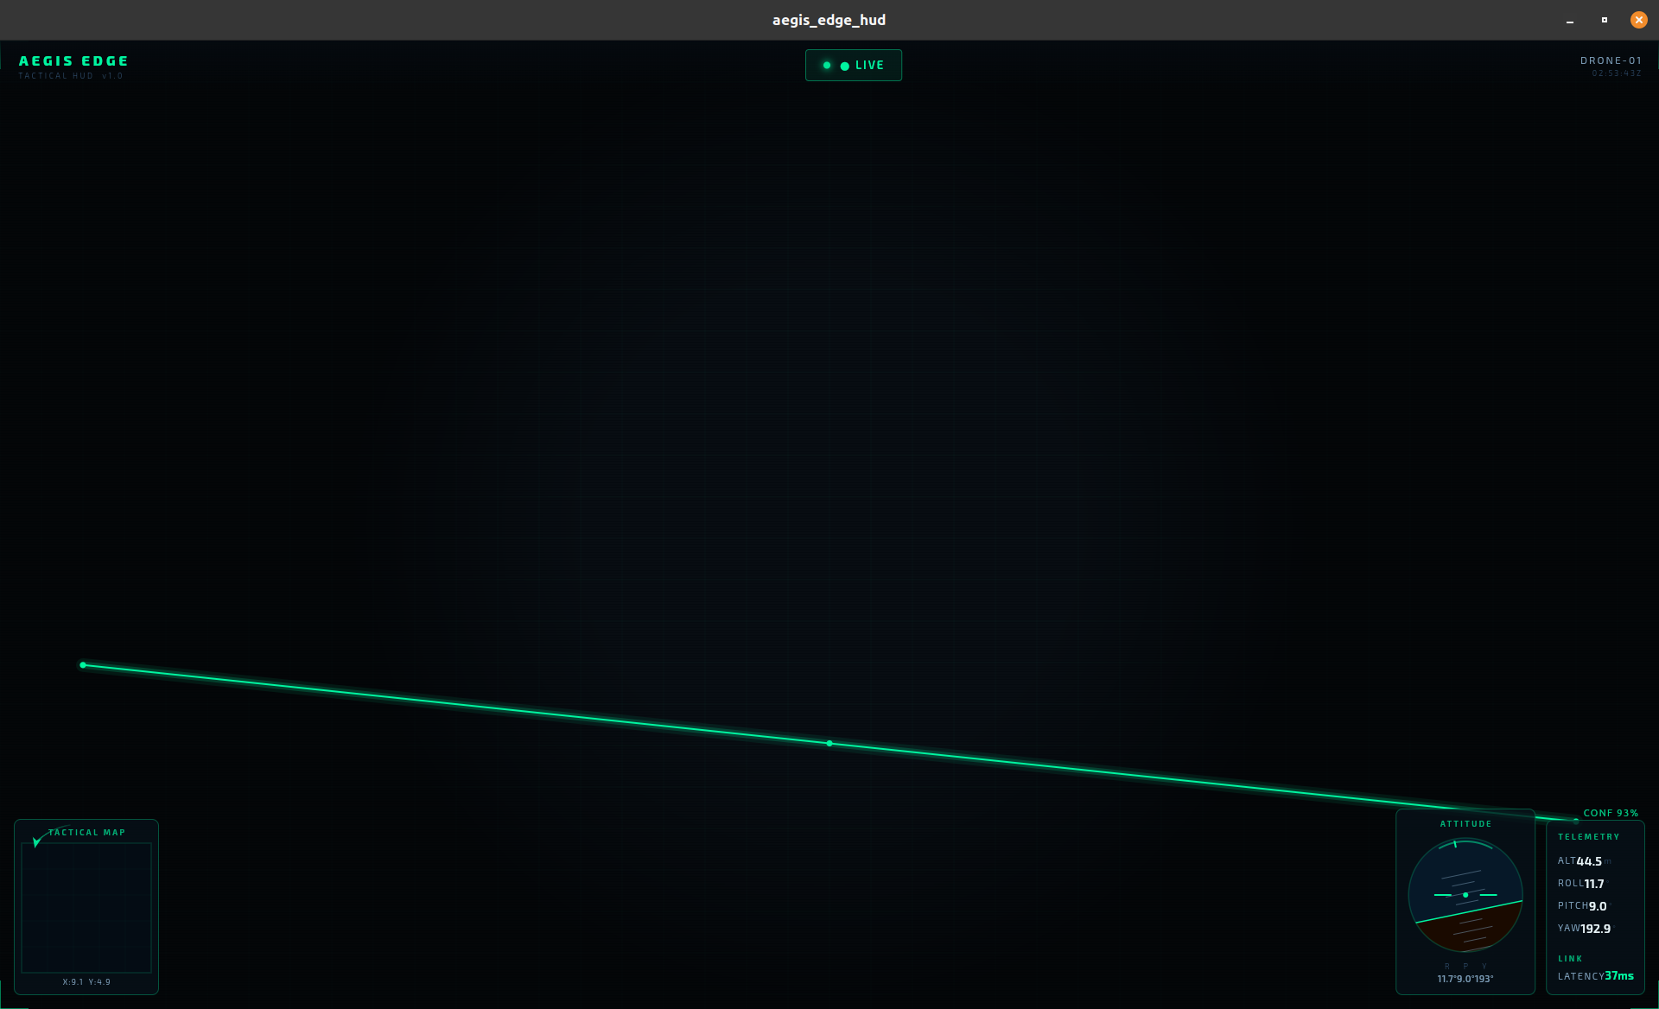
Resilient tactical HUD for degraded drone data links
Aegis Edge keeps drone operators informed when telemetry, video, or horizon data becomes delayed, degraded, or lost.

Slide 4
Drone data is not always trustworthy
In contested environments, drone links become slow, unstable, or interrupted.
Operators still need to understand what is happening.
A classic HUD displays data, even when that data may be stale.
The real issue is not only data loss. It is uncertainty.
When the link degrades, the operator must know what can still be trusted.

Slide 5
Aligned with real-time horizon awareness on edge systems
Primary fit: Real-Time Horizon Detection
Horizon information helps separate ground from sky.
This can reduce false positives and improve targeting pipelines.
Our prototype focuses on lightweight horizon representation and real-time HUD integration.
Designed with edge constraints in mind: low latency, simple data format, robust behavior.

Slide 6
A HUD that understands data reliability
Receives drone telemetry and horizon points.
Measures data freshness and latency.
Classifies the link state as NORMAL, DEGRADED, or LOST.
Keeps the last valid data when the signal is interrupted.
Shows the operator whether the current view is live, delayed, or stale.

Slide 7
From simulated drone data to resilient tactical display
Drone Simulator / Video Source
↓
Horizon Points JSON
↓
Chaos Proxy
↓
C++ Trust Core
↓
Flutter Tactical HUD

Slide 8
The system adapts to link quality
Latency < 300 ms → NORMAL
Latency < 2000 ms → DEGRADED
Latency ≥ 2000 ms → LOST
No packet received → LOST

Slide 9
Demo: controlled failure and recovery
Drone simulator sends normal telemetry.
HUD displays live attitude, altitude, latency, and horizon line.
Chaos proxy introduces lag.
HUD switches to DEGRADED.
Signal is cut.
HUD switches to LOST and keeps last valid data.
Signal returns.
HUD recovers to NORMAL.

Slide 10
Operational value
Better situational awareness under degraded communications.
Clear distinction between live and stale data.
Lightweight architecture suitable for edge systems.
Simple JSON protocol for integration with other modules.
Foundation for future distance estimation, altitude correction, and target filtering.

